Slide 1
Plans for the course from here on out
Week 11 – Cambio 3.0
Survey of remaining feedbacks we’ll be implementing in Cambio
In-class work on Cambio (ScheduledFlowsWithLTE, Cambio 3.0)
Brainstorm ideas for projects and social change organizations
Week 12
Have a discussion with a guest speaker on social change movements
Hear your investigations (presentations) into the relevance of social movements of the past as a model for a climate movement
Get an introduction to climate statistics
Week 13
Climate Statistics (and Thanksgiving)
Week 14
Monday: Group work on your research projects
Wednesday and Friday: 15-minute Project Presentations, with me filling in with course review slides
Week 15
Course wrap-up

Slide 2
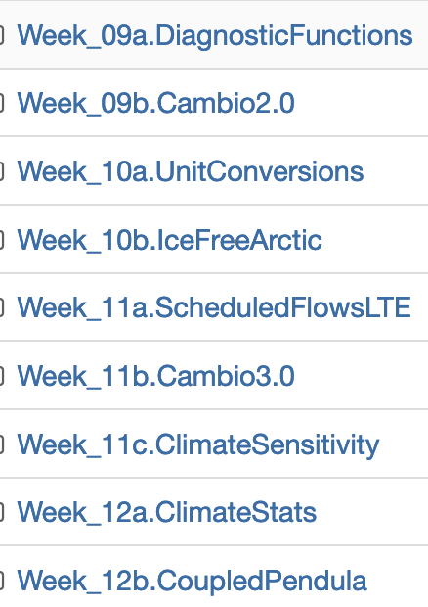
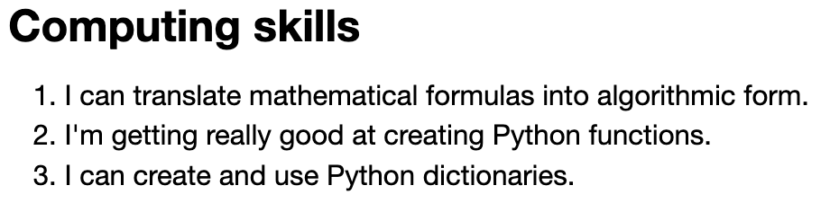
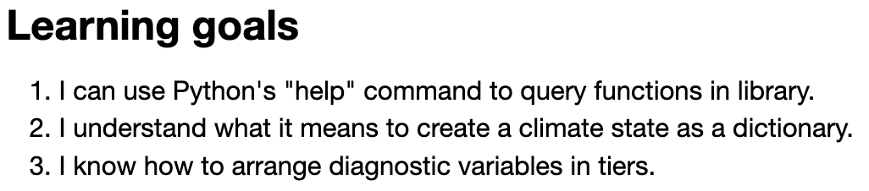
Assigning a grade for the course
Category | Significant gaps | Mostly there | Great command
CGIs
Discussion
Research Notebook
Interviews
Project
Check out the learning goals & skills listed at the bottom of the Introduction of each CGI:

Slide 3
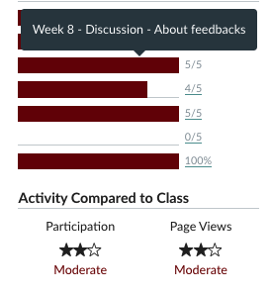
Assigning a grade for the course
Category | Significant gaps | Mostly there | Great command
CGIs
Discussion
Research Notebook
Interviews
Project

Slide 4
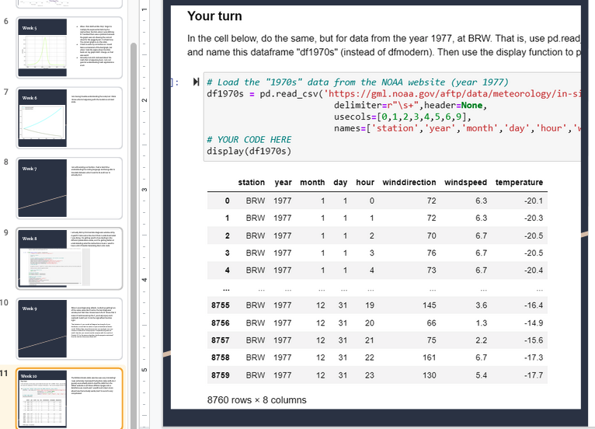
Assigning a grade for the course
Category | Significant gaps | Mostly there | Great command
CGIs
Discussion
Research Notebook
Interviews
Project

Slide 5
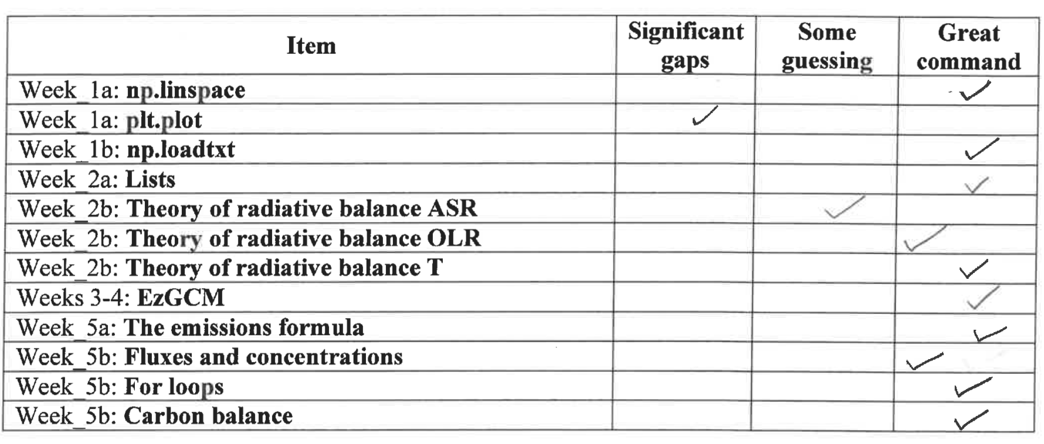
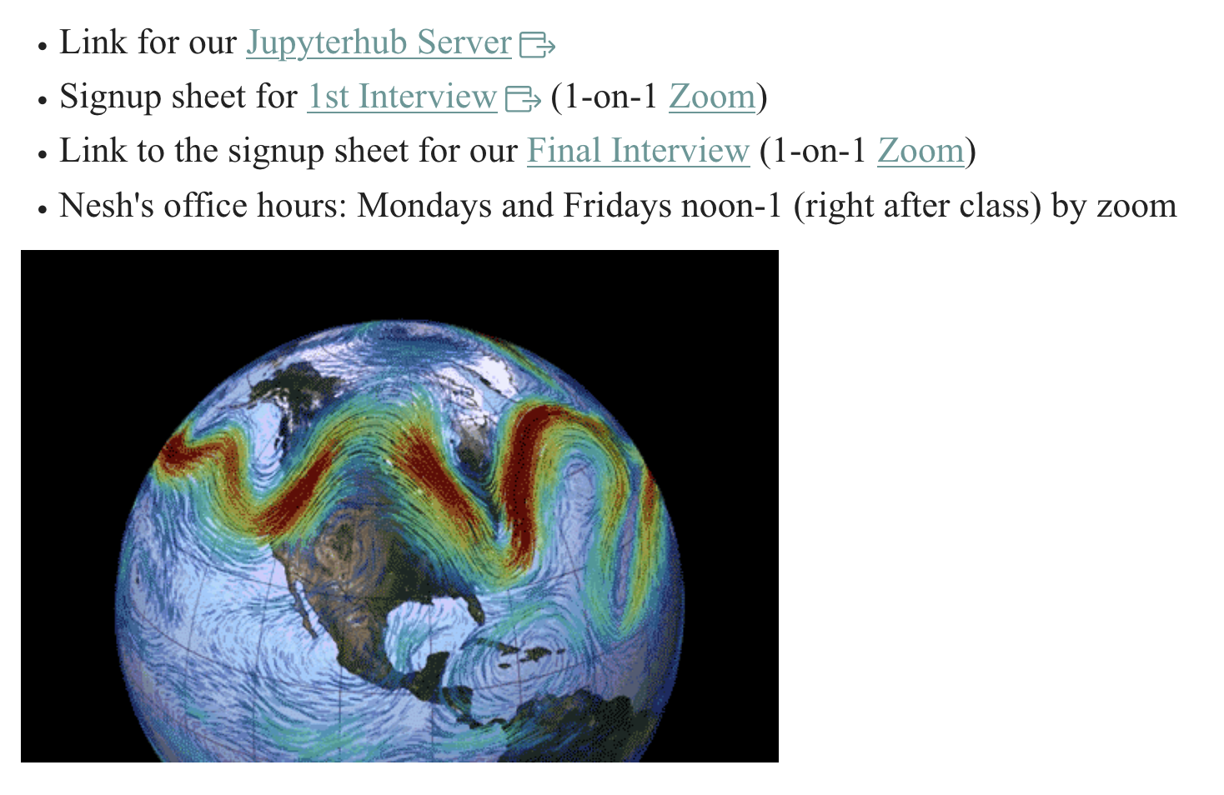
Assigning a grade for the course
Category | Significant gaps | Mostly there | Great command
CGIs
Discussion
Research Notebook
Interviews
Project
Sign up for a slot Finals Week.

Slide 6
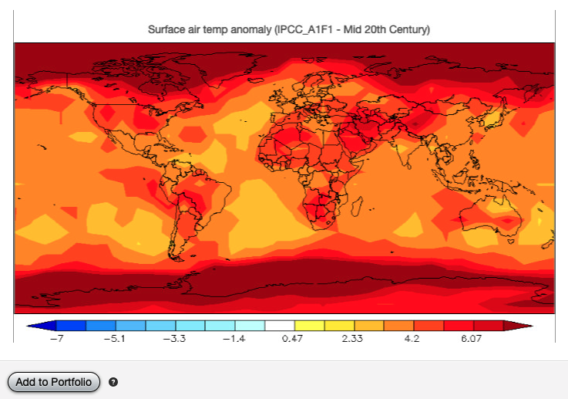
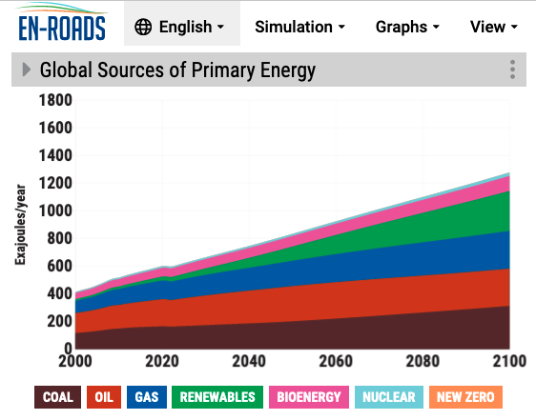
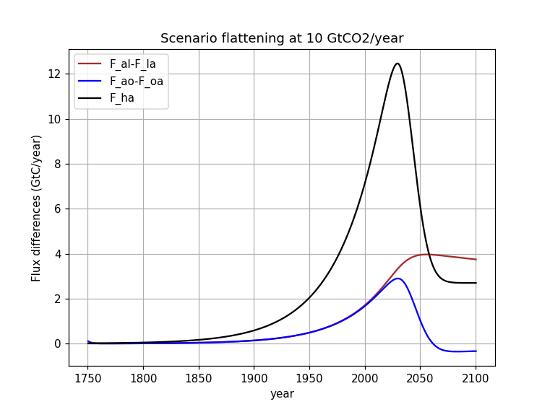
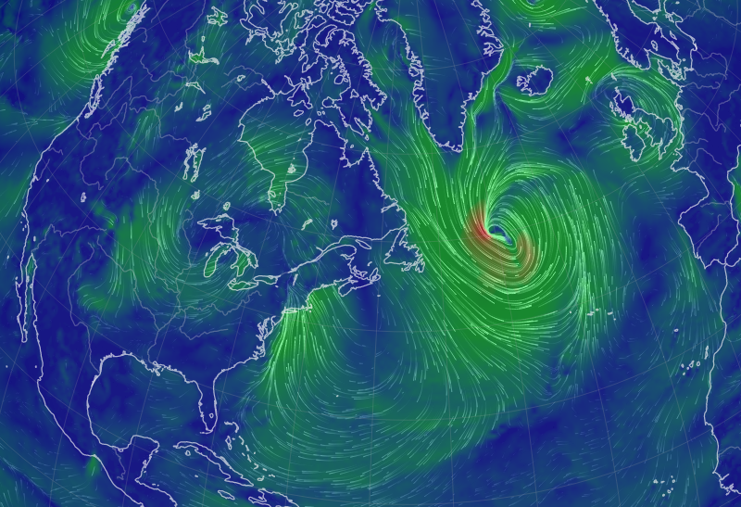
Assigning a grade for the course
Category | Significant gaps | Mostly there | Great command
CGIs
Discussion
Research Notebook
Interviews
Project

Slide 7
Assigning a grade for the course
Category | Significant gaps | Mostly there | Great command
CGIs |  |  | x
Discussion |  | x
Research Notebook |  |  | x
Interviews |  |  | x
Project |  |  | x
Looks like an “A”
Category | Significant gaps | Mostly there | Great command
CGIs |  | x
Discussion |  |  | x
Research Notebook |  | x
Interviews |  | x
Project |  |  | x
Looks like an “B”
Category | Significant gaps | Mostly there | Great command
CGIs |  | x
Discussion |  |  | x
Research Notebook | x
Interviews | x
Project |  | x
“C” or “D”

